Slide 1
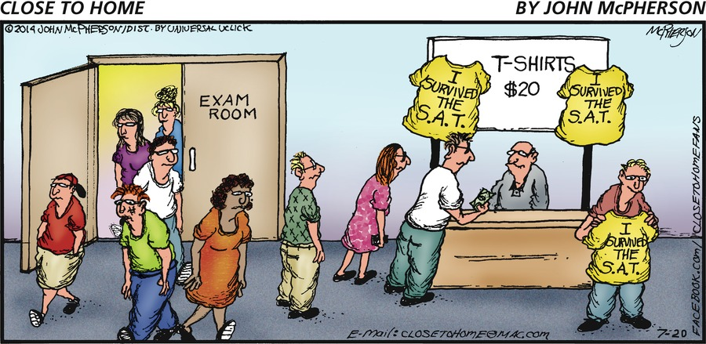
ACT Prep
Rasp & Stanolis

Slide 2
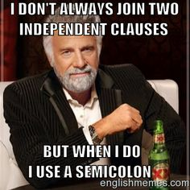
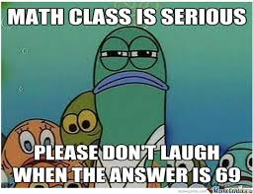
Structure
English (Mondays)
45 minutes 75 questions
Math (Tuesdays)
60 minutes 60 questions
Reading (Wednesdays)
35 minutes 40 questions
Science (Thursdays)
35 minutes 40 questions
Writing (Fridays)
Optional
40 minutes 1 Essay

Slide 3
Scoring
A range of 1-36
Most universities and colleges look at the composite score
Composite score = average of all 4 tests

Slide 4
Increasing your composite
Re-enforce your weaknesses
Maximize your strengths
“You do not have to be a rock star on all four tests.” *
*Cracking the ACT 2016b Edition, The Princeton Review

Slide 5
Enemies
Time – you will get used to being timed
Most times you have less than a minute per question
Yourself- test anxiety
Anti-anxiety calming methods
New test taking methods

Slide 6
POOD
Personal Order of Difficulty (POOD)
We will help you find your own POOD-when to answer types of questions
Now- Does the question look okay? Can you answer it?
Later- Will this question take a long time? Circle it and come back.
Never- Know the topics that are your worst. Don’t waste time on these unless you have answered everything else!

Slide 7
Pacing
We will learn how much time to spend on each type of question.
We do not want to spend all of our time on 20 questions leaving 40 unanswered

Slide 8
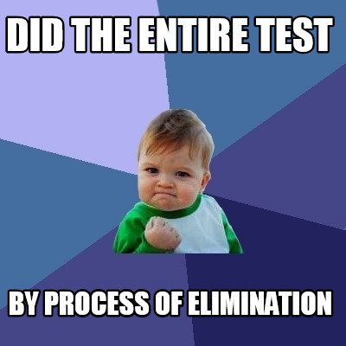
POE
Process of Elimination (POE)
Multiple Choice test provide the answer in front of you
We will learn how to decide how to eliminate incorrect answers

Slide 9
Be Ruthless
Don’t let one tough question drag you down
Keep movin’ on, keep movin’ on

